Slide 1
Player Statistics Visualization
using PCA & UMAP
M. Siri Chandana - 2520030603
Ili. Harshika - 2520030607

Slide 2
Introduction
Sports analytics plays an important role in evaluating player performance and supporting decision-making in football. Modern football generates large amounts of player statistics, including matches played, goals, assists, shots, passing statistics, tackles, and other performance metrics. Analyzing these multiple statistics together can be difficult and time-consuming.
Machine learning techniques can help simplify and visualize such complex data. In this project, Principal Component Analysis (PCA) and Uniform Manifold Approximation and Projection (UMAP) are used to reduce multiple player-performance features into a two-dimensional representation.
The resulting visualizations help identify similar player profiles, groups, and performance patterns. The main objective of the project is to compare PCA and UMAP and demonstrate how dimensionality reduction can make football player statistics easier to understand and analyze.

Slide 3
Abstract
Sports analytics has become increasingly important for evaluating football player performance and supporting strategic decision-making. Modern football generates large amounts of player-performance data, including matches played, goals, assists, shots, passing statistics, and other metrics. Analyzing these features together can be difficult, making it challenging to identify similarities and performance patterns among players.
This project, “Player Statistics Visualization Using PCA and UMAP,” aims to simplify player statistics using Principal Component Analysis (PCA) and Uniform Manifold Approximation and Projection (UMAP). The selected performance features are processed and transformed into a two-dimensional representation while preserving important information from the original data.
The results are visualized using 2D scatter plots, where players with similar performance characteristics appear closer together. This helps identify similar player profiles and performance patterns while allowing a comparison of PCA and UMAP . The project demonstrates how dimensionality reduction and machine learning can make complex football player statistics easier to visualize, analyze, and interpret.

Slide 4
Existing System
Traditional football player analysis mainly relies on tables, basic charts, and individual comparisons of statistics such as goals, assists, shots, passing, and tackles. However, analyzing multiple performance features simultaneously can be complex and time-consuming, making it difficult to visualize high-dimensional data, identify similar player profiles, and discover hidden performance patterns.

Slide 5
Proposed System
The proposed system uses Machine Learning-based dimensionality reduction techniques, PCA and UMAP, to simplify complex football player-performance data. The selected statistics are first preprocessed and standardized, and then transformed into a two-dimensional representation using PCA and UMAP. The resulting data is visualized through 2D scatter plots, helping to identify similar player profiles and performance patterns. Finally, the results of PCA and UMAP are compared to understand which technique provides a better representation of the player statistics.

Slide 6
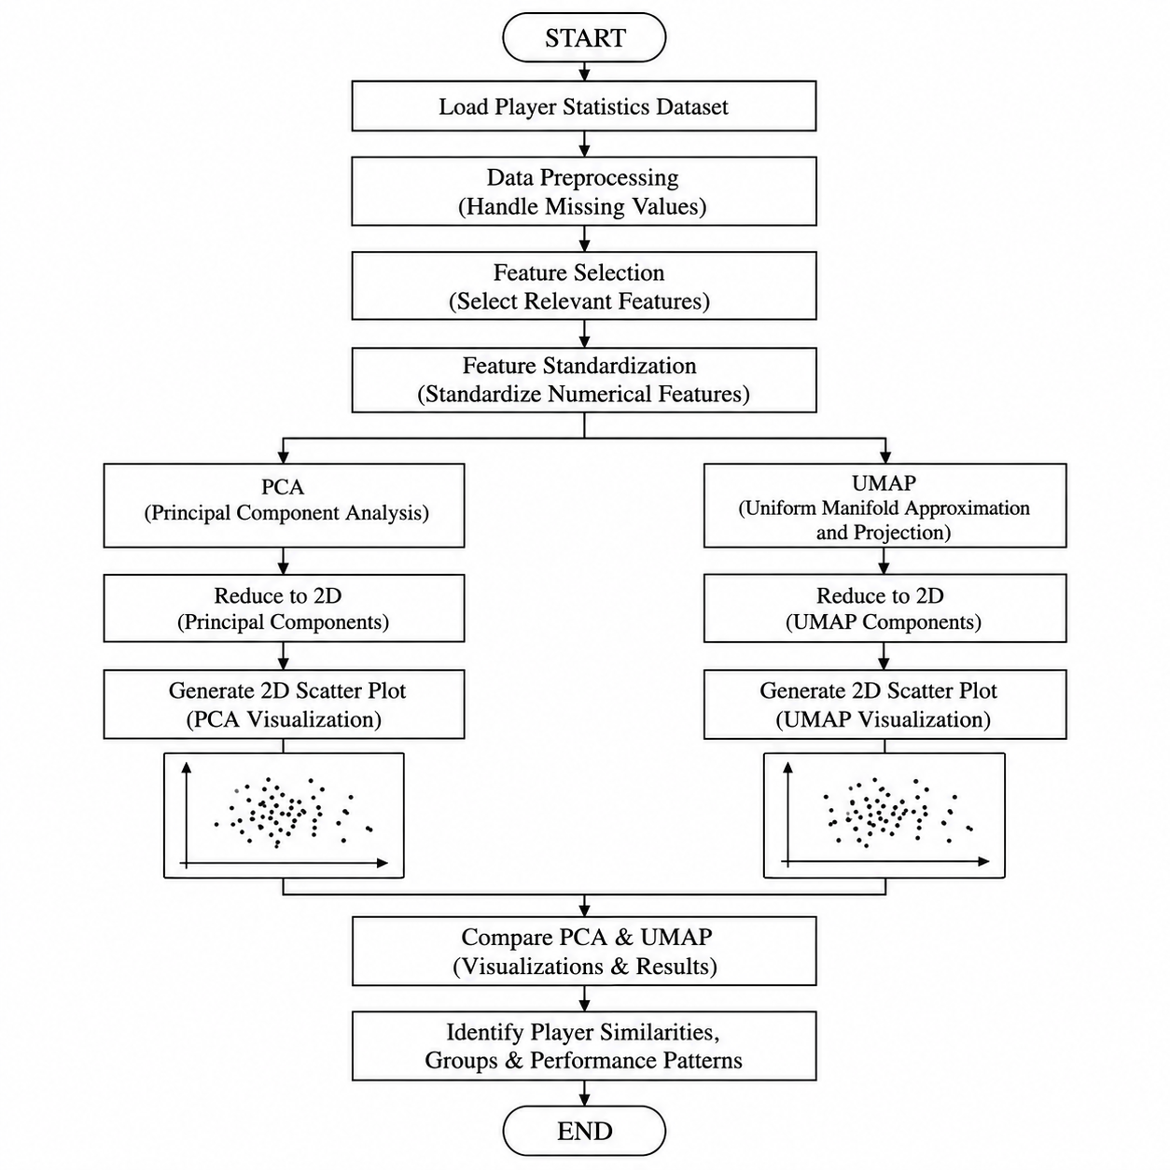
Flow Diagram

Slide 7
Algorithm
Load the football player statistics dataset.
Preprocess the data by handling missing values and selecting the required player-performance features.
Standardize the selected numerical features so that all features are on a comparable scale.
Apply PCA (Principal Component Analysis) to reduce the high-dimensional data into two principal components.
Apply UMAP (Uniform Manifold Approximation and Projection) to reduce the same data into two dimensions.
Generate 2D scatter plots for both PCA and UMAP to visualize player relationships.
Compare the PCA and UMAP visualizations to identify similar player profiles, groups, and performance patterns.
Analyze the results and determine how effectively PCA and UMAP represent the player statistics.

Slide 8
Expected Output
The project is expected to produce 2D scatter plot visualizations of football players using PCA and UMAP.
PCA Visualization: Represents players in a 2D space based on their performance statistics.
UMAP Visualization: Represents player relationships and groups in a 2D space.
Players with similar performance profiles are expected to appear closer together.
The visualizations will help identify player groups, similarities, and performance patterns.
A final comparison of PCA and UMAP will show how differently the two techniques represent the player data

